Slide 1


Computational Intelligence What is Computational Intelligence

Slide 2
Course Titles
Computational Intelligence
Soft Computing
Optimization Modeling

Slide 3

3

Slide 4
Lecture Organization
Computational Intelligence
AI verses CI
Foundations of CI
Applications of CI techniques
Metrics and Analysis
Way forward
Conclusions

Slide 5
Some Questions
What's Computational Intelligence (CI)?
What's Computation? How we achieve computation?
Hard Computing Vs. Soft Computing
How to achieve Soft Computing?
What's Hybrid Computing (Hard + Soft)?

Slide 6
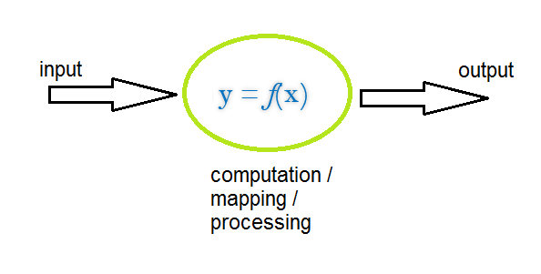
What is Computing?
Computing is:
Anything that requires computer to so something
“any goal-oriented activity that requires processing from computers”
Imagine a function y = f(x) or a rule R₁: I₁,I₂ -> I₃
Computer operates by accepting an input and produces output

Slide 7
f is also called
A control action
A formal method
An algorithm: steps to solve a problem
So computing is a mapping between input and output

Slide 8
What is programming
Computing is a massive field that touches almost every corner of modern society in some way.
Programming is the foundation of computing.
Programming is the act of creating instructions for a computer to carry out.
add 5 and 3,
fetch google.com,
save my document
Programming is writing the commands (called code) for a computer to perform.

Slide 9
Programming is everywhere
You interact with computer – you are dealing with programming in some way.
Even if you're not writing code yourself, you might be designing programs for someone else to code or designing the hardware that will run code.
Being able to program is like being able to speak a language.
You need to speak code to communicate in computing.
Like, You need to speak Urdu to communicate in Urdu
Just like learning to speak a new language is more than just memorizing vocabulary words, so also working in computing is also about more than just understanding how to write single lines of code. It's about understanding what writing code allows you to say and do.

Slide 10
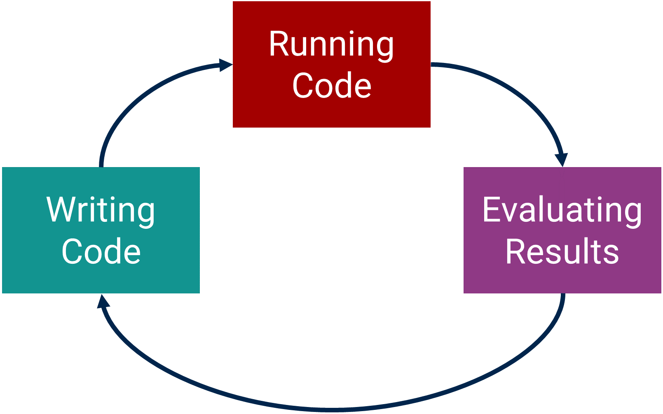
Programming – A 3 stage process
Programming is an iterative process of writing code, attempting to run it, and evaluating the results.
Coding is like doing anything:
You write a thesis – you read over it or you show it to your supervisor, and you evaluate it. Its repetitive process
You paint a painting, you show it to an audience or a mentor, and you plan how to improve your next one

Slide 11
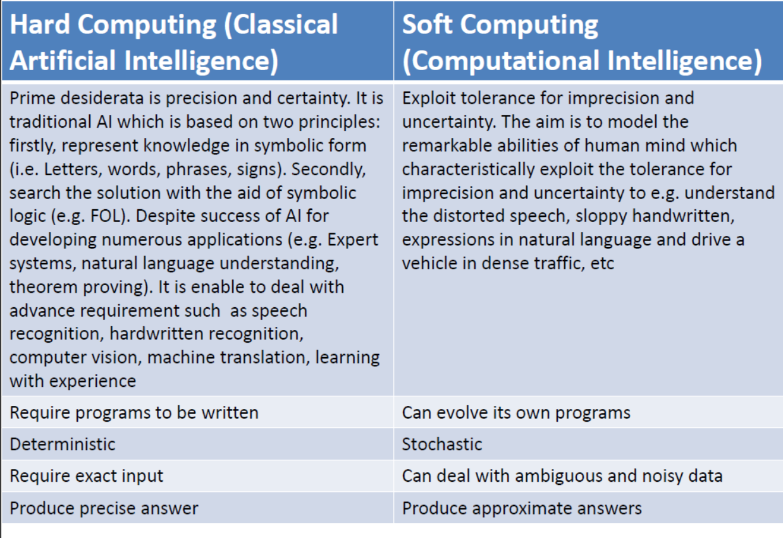

Slide 12
Computational Intelligence

Slide 13
What is Computational Intelligence (CI)?
CI deals with bio-inspired computational methods.
Its roots are in:
Cybernetics (http://www.asc-cybernetics.org/foundations/definitions.htm ) and
Soft-computing (https://en.wikipedia.org/wiki/Soft_computing).

Slide 14
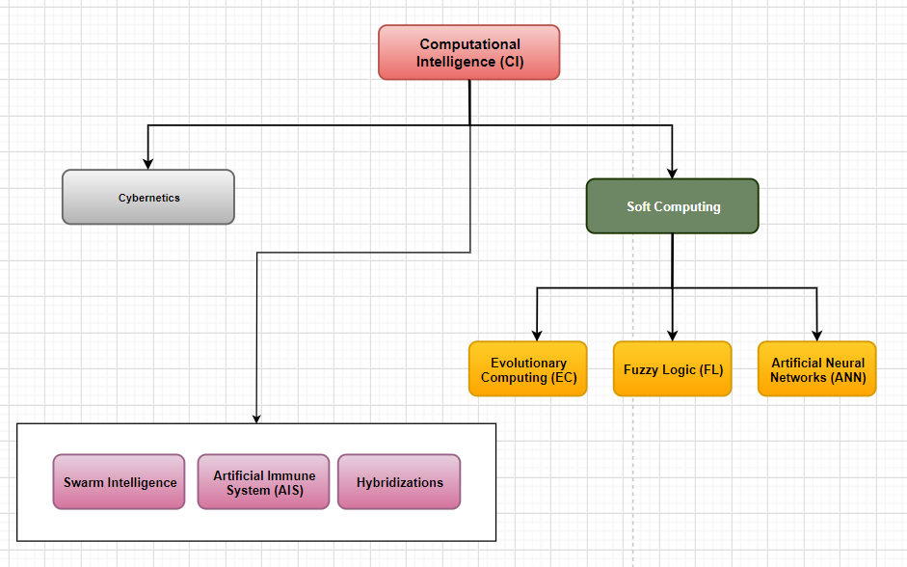
Computational Intelligence (CI) – the concept

Slide 15
What is Cybernetics
Cybernitics:
Norbert Wiener defined cybernetics in 1948 as "the scientific study of communications and automatic control systems in both animal and the machine." (Wikipedia)
Examples of cybernetic systems are various kinds of automatic control devices in engineering
an automatic pilot or a controller that maintains a constant temperature in a room
electronic computers,
the human brain,
biological populations, and
human society.

Slide 16
What is Soft Computing?
Soft Computing: With the human mind as a role model, soft computing is tolerant of partial truths, uncertainty, imprecision and approximation, unlike traditional computing models.
Started in 1990
Benefit of Soft Computing:
Can solve complex problems, otherwise unsolvable
The tolerance of soft computing allows researchers to solve some problems that traditional computing can't process.

Slide 17
What's soft computing
Soft computing has focused on
Evolutionary Computation (EC),
Fuzzy Logic (FL), and
Artificial Neural Networks (ANN)
But CI has a wider scope. >>>> CI = Cybernetics + Soft Computing
CI deals with other bio-inspired methods such as
Swarm Intelligence (SI) and
Artificial Immune Systems (AIS).
Their (ANN, FL, EC, SI, AIS) hybridizations/Fusions
CI may be considered as a branch of AI

Slide 18
What is Softcomputing ?
The idea of softcomputing was initiated in 1981 when Lofti A.Zadeh published his first paper on soft data analysis “what is softcomputing”, softcomputing. Springer-Verlag Germany/ USA, 1997.
Zadeh, define softcomputing into one multidisciplinary system as the fusion (or hybridization) of the fields of Evolutionary computing, Fuzzy Logic, Neuro-computing and Probabilistic Computing.
SC = EC + FL + NC + PC
Softcomputing Evolutionary Fuzzy Logic Neural Camp. Probabilistic

Slide 19
What is meant by fusion or hybridization ?
Hybridization create a situation where different entities cooperate advantageously for final outcome.
Use EC to fuzzy-logic-based systems to improve or optimize their performance
Conversely, user FL to genetic algorithms to improve the performance
Popular Examples:
Neuro-Fuzzy (NF) systems,
Fuzzy-Genetic (FG) systems,
Neural-Genetic (NG) systems,
Fuzzy-Neural-Genetic (FNG) systems,
Fuzzy-Probablistic (FP) systems
adaptive neuro-fuzzy inference system (ANFIS)

Slide 20
SC = EC + NC + FL + PC
NC (Neural computing): provides effective algorithms of simple, highly interconnected processing units, , which process information by their dynamic state response to external inputs, for the purpose of system identification, classification, learning and adaptation.
Includes FFNN, BPNN, CNN, RNN
EC (Evolutionary computing): primarily apply “systematic random search” - usually directed at finding an optimum solution to a problem.
Includes Genetic Algorithms, Genetic Programming, Evolutionary Algorithms, Evolutionary Strategies
FL (Fuzzy Logic): provides ability to handle vague situations where we can't decide whether the statement is true or false. FL is based on "degrees of truth" and offer flexibility to reasoning uncertainty and imprecision
Includes Membership degree, Fuzzification, Fuzzy if-then rules, fuzzy inference engine, defuzzification
PC (Probabilistic computing): provides the probability theory and the subsidiary techniques for decision-making under uncertainty.

Slide 21
Computational Intelligence - Definitions
Computational intelligence comprises practical adaptation and self-organization concepts, paradigms, algorithms and implementations that enable or facilitate appropriate actions (intelligent behavior) in complex and changing environments. (Engelbrecht, 2007).
Computational intelligence (CI) is a set of nature-inspired computational methodologies and approaches to address complex real-world problems.

Slide 22
Computational Intelligence (CI) - Concepts
Computational Intelligence:
is a sub-branch of AI and;
AI started in 1950s, CI – in 1990s
Hard Computing versus Soft Computing:
Traditional AI: precision and certainty;
Soft computing exploit the tolerance for imprecision, uncertainty and partial truth to achieve tractability, robustness, low solution cost and better rapport with reality. (Lotfi Zadeh, 1998)

Slide 23
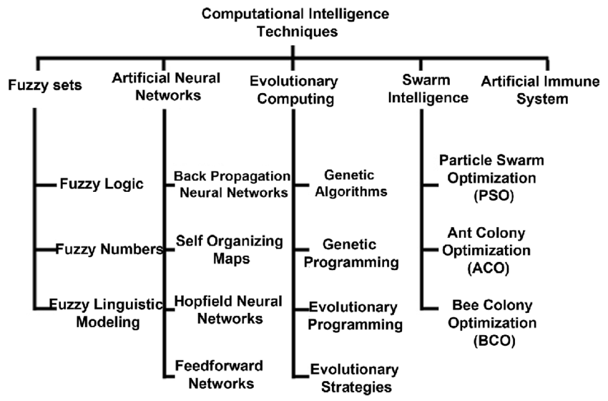
Taxonomy of Computational Intelligence Techniques

Slide 24
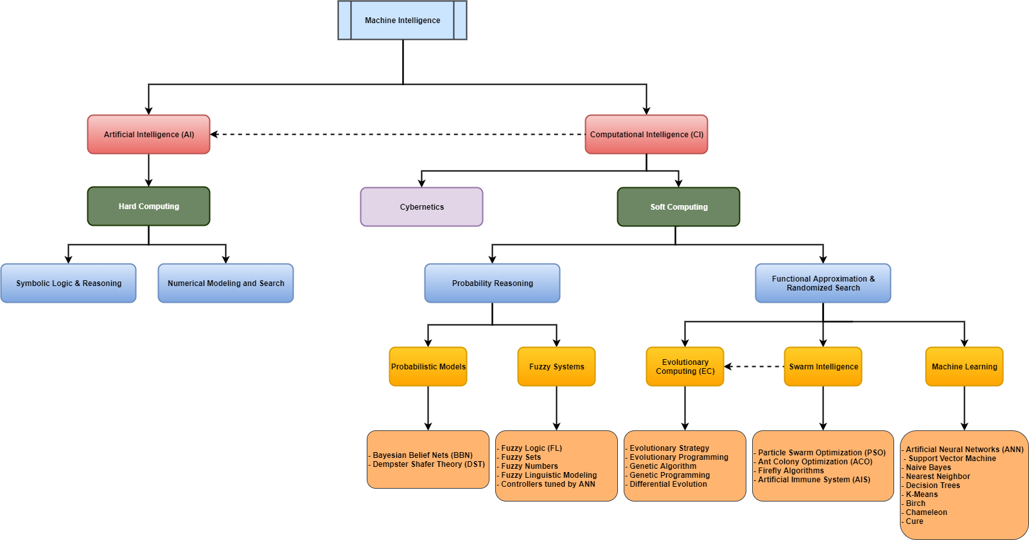


Slide 25
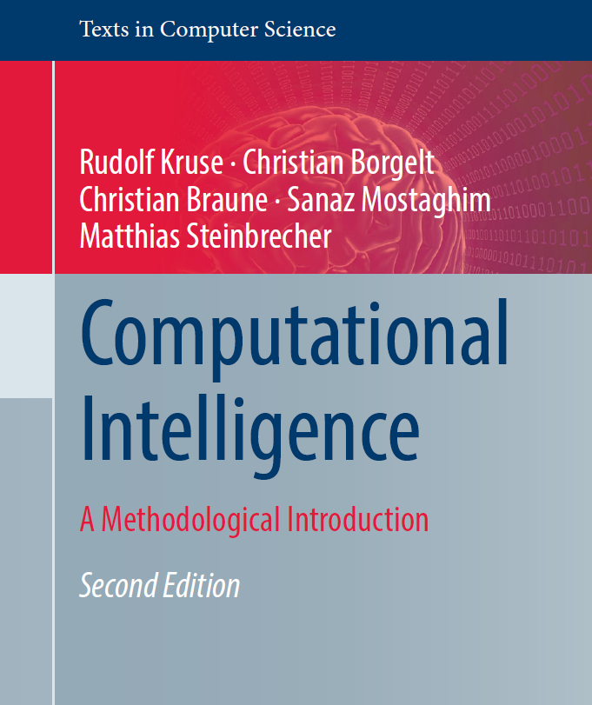
Rudolf Kruse · Christian Borgelt
Christian Braune · Sanaz Mostaghim
Matthias Steinbrecher
Computational Intelligence
A Methodological Introduction
Second Edition
2016

Slide 26
Soft computing – Neural Networks
Logistic Regression
Multi-Layer Perceptron
Gradient Decent and Backpropagation
Radial Basis Function Networks
Self-organizing Maps
Support vector machines
Hopfield Networks
Convolutional Neural Networks CNN
Recurrent Networks RNN
LSTM
GRU
Evolutionary Algorithms
The n-Queens Problem using various ways
Bayesian Networks / Reasoning
Expert systems
Cluster Analysis
Hill Climbing
Simulated Annealing
Great Deluge Algorithm
Record-to-Record Travel

Slide 27
Library of Nature-Inspired Algorithms Choose algorithm for your semester project
Genetic Algorithm (GA)
Particle Swarm Optimization (PSO)
Ant Colony Optimization (ACO) Algorithm
Bee Colony Optimization (BCO) Algorithm
Simulated Annealing (SA)
Teaching Learning based Optimization (TLBO)
Fruit Fly Optimization (FFO) Algorithm
Sine Cosine Algorithm (SCA)
Cuckoo Search Algorithm (CS)
Artificial Fish School
Low Level Hybrid Cuckoo Peer Learning from TLBO
High Level Hybrid Sine Cosine Jaya
(Adaptive) Monte Carlo Hyper-Heuristic
Artificial immune systems (AIS)
Memetic Algorithm (MA)
Cultural Algorithms (CA)
Self-propelled Particles
Differential Evolution (DE)
Bacterial Foraging Optimization
Marriage in Honeybees (MHB)

Slide 28
Soft computing - fields of study
Metaheuristics
Bayesian Networks / Reasoning
Differential algorithms
Support vector machines
Expert systems
Cluster Analysis
Hybrid Intelligent Methods
Fuzzy Control Systems

Slide 29
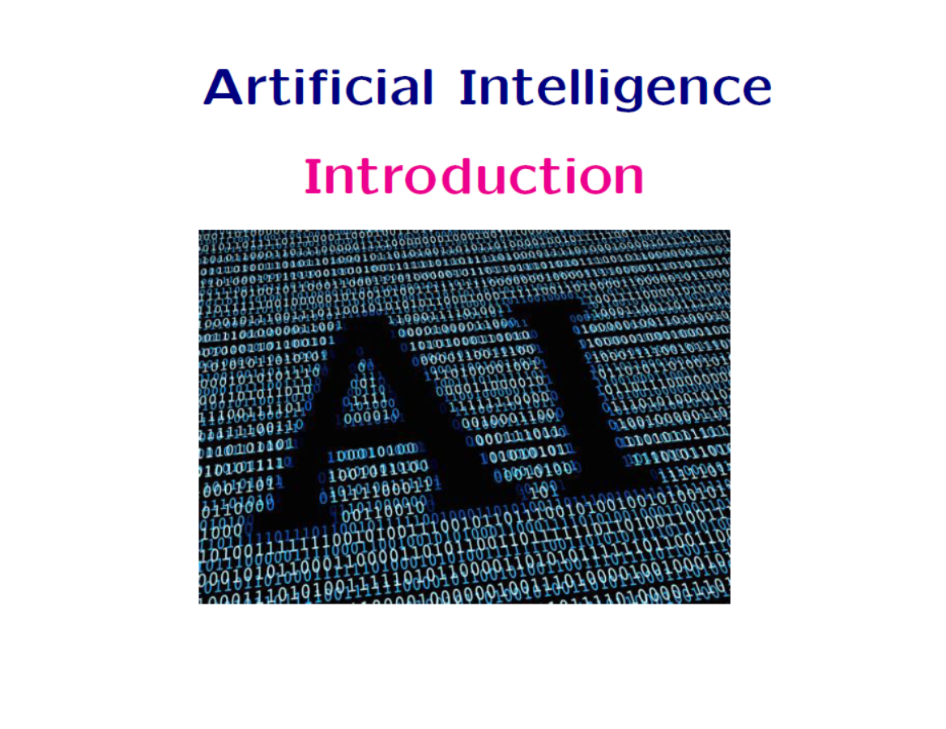

Slide 30
Definition of AI
“Intelligence: The ability to learn and solve problems”
Webster’s Dictionary.
“Artificial intelligence (AI) is the intelligence exhibited by machines or software’
Wikipedia.
“The science and engineering of making intelligent machines”
McCarthy.
“The study and design of intelligent agents, where an intelligent agent is a system that perceives its environment and takes actions that maximize its chances of success.”
Russel and Norvig AI book.

Slide 31
What is AI? Four schools of thoughts (Russel & Norvig)
Thinking humanly | Thinking rationally
“The exciting new effort to make computers think... machines with minds, in the full and literal sense.” (Haugeland, 1985) | “The study of mental faculties through the use of computational models.” (Charniak and McDermott, 1985
Acting humanly | Acting rationally
“The study of how to make computers do things which, at the moment, people are better.” (Rich and Knight, 1991) | “Computational Intelligence is the study of the design of intelligent agents.” (Poole et al., 1998)

Slide 32
What is AI? Thinking humanly: cognitive approach
Requires to determine how humans think!
1960’s “cognitive revolution”.
Requires scientific theories of internal activities of the brain
What level of abstraction? “Knowledge” or “circuits”?
How to validate?
Today, Cognitive Science and Artificial Intelligence are distinct disciplines.

Slide 33
What is AI? Acting humanly:
Turing test (Alan Turing 1950):
A computer passes the test of intelligence, if it can fool a human interrogator.
Major components of AI:
knowledge,
reasoning,
language,
understanding,
learning.

Slide 34
What is AI? Thinking rationally: Laws of thoughts
Codify “right thinking” with logic.
Several Greek schools developed various forms of logic: notation and rules of derivation for thoughts.
Problems:
Not all knowledge can be expressed with logical notations.
Computational blow up.

Slide 35
What is AI? Acting rationally:
The Approach: “Computational Intelligence is the study of the design of intelligent agents.”
(Poole et al., 1998)
The right thing: that which is expected to maximize goal achievement, given the available information.
A rational agent is one that acts so as to achieve the best outcome, or when there is uncertainty, the best expected outcome.
Aristotle (Nicomachean Ethics):
“Every art and every inquiry, and similarly every action and pursuit, is thought to aim at some good.”

Slide 36
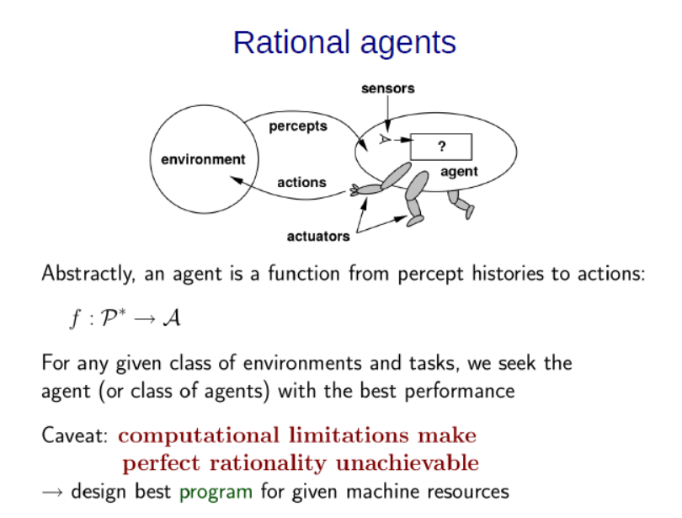

Slide 37
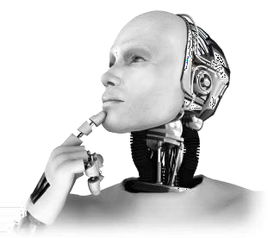
What is Artificial Intelligence?
“The ability to learn/understand/deal with new situations”
“The study of how to make computers do things at which people are doing better”(IEEE, 1996)
“[…] area of Computer Science that study techniques to create Intelligent Systems”(Nilsson, 1998)
“Intelligent behavior involves perception, reasoning, learning, communicating and action in complex environments”(Nilsson, 1998)
37

Slide 38
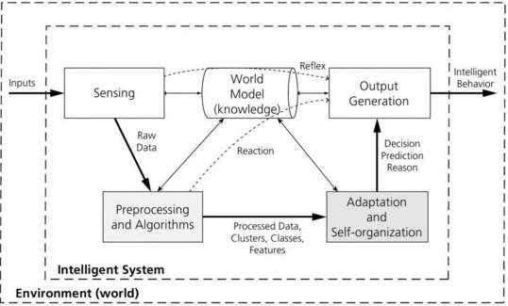
Relationships among components of intelligent systems (AI):

Slide 39
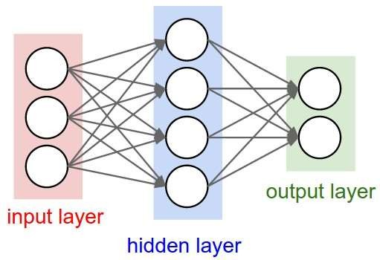
#1. Artificial Neural Networks
Inspired in biological neural systems;
Ability to learn, memorize and still generalize;
Techniques:
Multilayer Perceptron (MLP),
Radial Basis Function (RBF)
Probabilistic Neural Network (PNN)
Applications:
Function/time series approximation;
Control process and optimization;
Pattern Recognition/classification;
Clustering;
Associative memories;
Input layer, Hidden Layer (s), Output layer
# of Neurons in each layer
Parameters (weights and biases)
Hyper-parameters (Learning rate, Activation functions, evaluation metrics, loss optimization, pooling, dropouts)

Slide 40
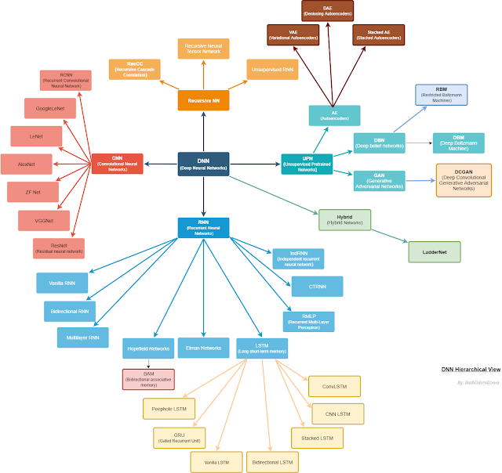
DNN Types

Slide 41

#2. Evolutionary Computation Systematic Stochastic Search
Evolutionary Computation has an objective to mimic processes from natural evolution;
Genetic Algorithms,
Genetic Programming,
Evolutionary Programming,
Evolution Strategies and so on;
Applications:
Data mining;
Combinatorial optimization;
Fault diagnosis;
Classification and Clustering;
Time series approximation;

Slide 42
#2. Evolutionary Computation (Cont.)
Genetic Algorithms (generation >> evaluation >> selection process)
Construction of genome (individual)
Generation of initial population (group of individuals)
Evaluation of individuals
Selection of individuals based on criteria
Generation of new individuals
Mutation
Crossover
Repetition of the process - generation, evaluation, selection
Termination of the process based on max generation no. and/or performance criteria

Slide 43
Research Interests in Evolutionary Computation
Many real-world optimization problems are difficult to solve because, in part, they have an exponential number of possible solutions---exhaustively looking at each one to find the best solution is not feasible.
The class of NP-complete problems fall into this category.
We can, however, collect all possible solutions onto a hyper-surface, where each point corresponds to a unique solution.
We can then design a computer algorithm that explores this hyper-surface, searching for the globally best solution.
Unfortunately, this search process is not trivial because the hyper-surface often contains numerous local optima.
The only hope of finding a reasonably good solution is to conduct a heuristic search.
The field of evolutionary computation (EC) involves the study and development of algorithms that simulate Darwinian evolution to conduct a search.
Four fundamental algorithms are the genetic algorithm, genetic programming, the evolution strategy, and evolutionary programming.

Slide 44
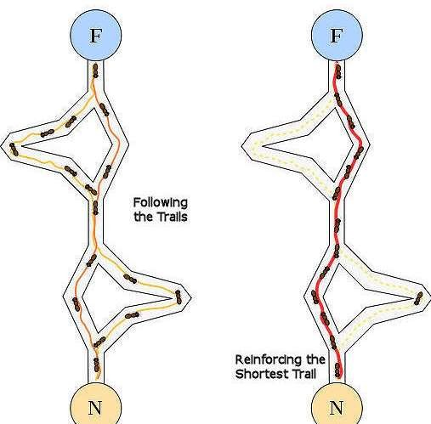
#3. Swarm Intelligence
Swarm Intelligence originated from the study of colonies or swarms of social organisms;
Applications:
Shortest path optimization;
Graph coloring;
Scheduling;
Clustering;
Techniques:
Particle Swarm Optimization (PSO);
Ant Colony Optimization (ACO);
Artificial Bee Colony (BCO);

Slide 45
Research Interests in Swarm Algorithms
Particle swarm optimization (PSO) is an optimization and problem-solving approach that uses swarm intelligence.
The analogy is to a swarm of insects or a school of fish.
If one sees a desirable path to go (e.g., for food, protection, etc.) the rest of the swarm will be able to follow quickly from every location.
In addition, each particle has some randomness of movement.
This is modeled by particles in multidimensional space.
Particles have positions and velocities.
They communicate their knowledge to other particles.

Slide 46

#4. Fuzzy Systems
Fuzzy Systems are inspired in human reasoning and approximate reasoning;
Techniques:
Mamdani’s Fuzzy Inference System;
Takagi-Sugeno-Kang FIS;
Fuzzy C-Means (FCM);
Applications:
Control systems;
Gear transmission and Braking systems;
Controlling lifts;
Classification and clustering;
Function approximation;

Slide 47
#4. Fuzzy Systems (cont.)
Steps involved
Fuzzification using membership functions (MFs)-input
Generation of rule-base
Aggregation / Inference
Defuzzification using MFs -output

Slide 48
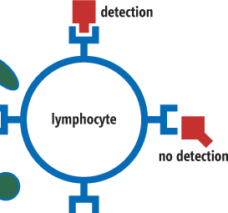
#5. Artificial Immune Systems
NIS has a great pattern matching ability, used to distinguish between foreign cells (antigen);
AIS models some of the aspects of a NIS;
Techniques:
Clonal selection;
Danger theory;
Network theory;
Applications:
Pattern recognition problems;
Classification tasks;
Cluster data;

Slide 49
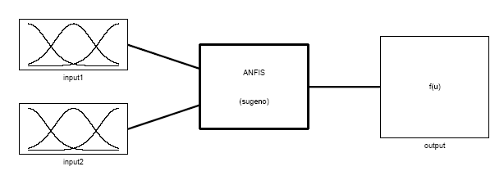
#6. Hybrid CI Techniques
Fuzzy Logic + ANN
Adaptive neuro-fuzzy inference system (ANFIS)
Starts with an initial Fuzzy Logic (FL) structure
Uses ANN for adapting the FL (MF) parameters and the rule base to the training data

Slide 50
#6. Hybrid CI Techniques
Combine advantages of GA and other classifiers
GA and ANN
GA and ANFIS
GA and SVM

Slide 51
Applications of CI
Computer Science
Pattern Recognition (PR)
Data Mining
Knowledge Discovery/ Machine Learning
Feature Extraction and Selection
Mechanical Systems
Condition monitoring and diagnostics
Multiobjective optimization in design
Control System Design
Manufacturing Systems
Development of data-driven models
Multiobjective optimization of machining parameters >>
Multiobjective optimization of machining parameters Minimization of machining cost
Minimization of surface roughness
Minimization of production time
Subject to constraints on
Operating parameters –speed, feed, depth of cut
Cutting Force
Power consumption

Slide 52
Applications of CI (Cont.)
Engineering Management
Inventory management
Project selection
Facility layout design
Scheduling
Medicine
Patient condition monitoring and diagnosis
Social Science
Business
Market analysis and forecasting
Credit rating

Slide 53
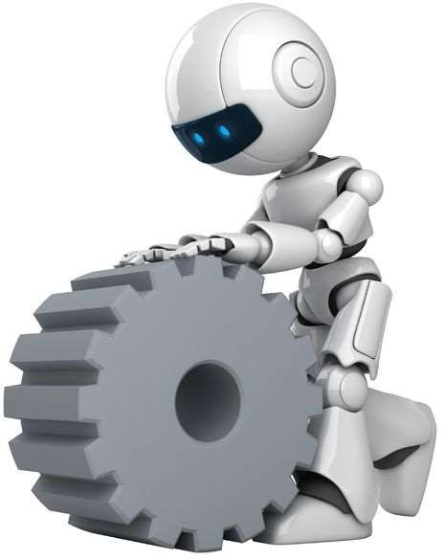
Applications
Another applications of CI in real-world problems:
Robotic;
Natural Language Processing;
Facial and speech recognition;
Game playing;
Healthcare;
Finance & Banking;
Machine Learning;
Military Equipment;

Slide 54







Implementation
Computational Intelligence Tools:
When a researcher needs to use CI techniques, it is necessary to
implement them and adapt them to the specific problem;
Programming languages: Java, Python, C++;
Frameworks/Tools/APIs:

Slide 55
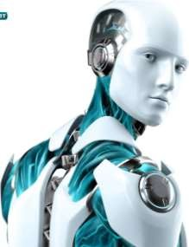
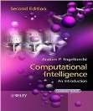
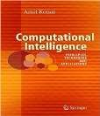
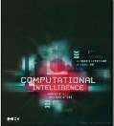
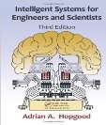
More Books
Computational Intelligence: An Introduction
Andries Engelbrecht;
Computational Intelligence: Principles, Techniques and Applications
Amit Konar;
Computational Intelligence: Concepts to Implementations
Russell Eberhart;
Intelligent Systems for Engineers and Scientists
Adrian Hopgood;

Slide 56
Conclusions
Increasing popularity of CI techniques
Integrating capability over multiple disciplines
Capability of incorporating imprecision and uncertainty
Suitability for hard-to-model processes /systems
Better alternatives to traditional hard computing scenario

Slide 57

Thoughts
High Development Cost
Difficult to Solve (NP-hard)
Error Prone Implementations
Fuzzy / Uncertain
Hybrid Systems
Markov / Beysian
Integration with other Systems

Slide 58
Course Titles
The End

